Slide 1
FuncScene: Function-centric Indoor Scene Synthesis via a Variational AutoEncoder Framework
Wenjie Min Wenming Wu Gaofeng Zhang Liping Zheng
Hefei University of Technology

Slide 2
Background

Slide 3
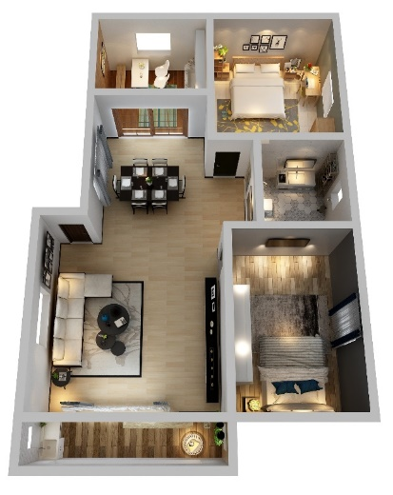
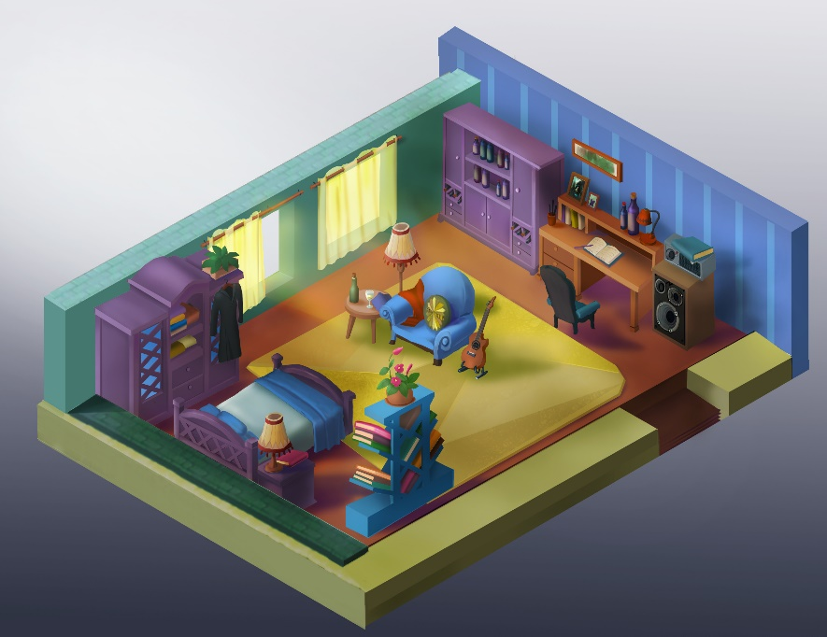
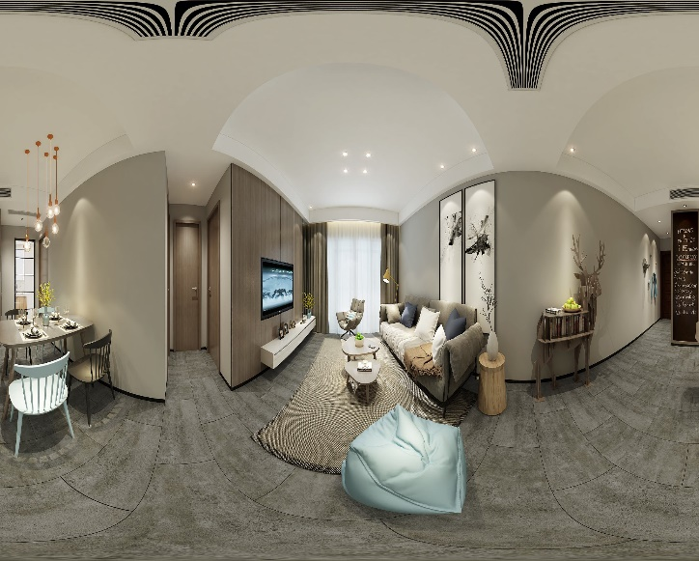
Application Scenarios
Indoor design
Electronic game
Virtual Reality

Slide 4
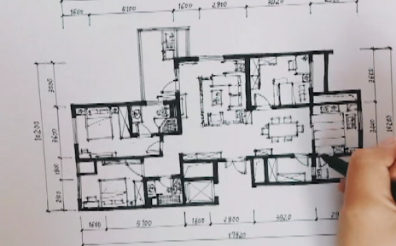
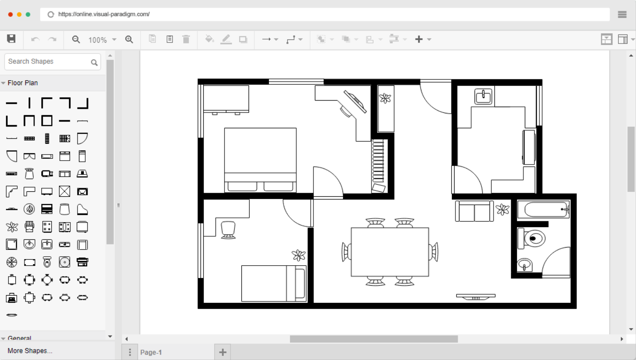
Motivation
Handcrafted
Computer-aided Design

Slide 5
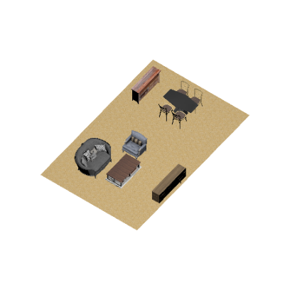
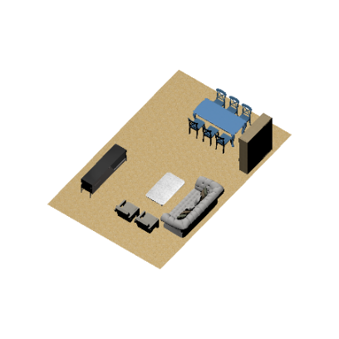

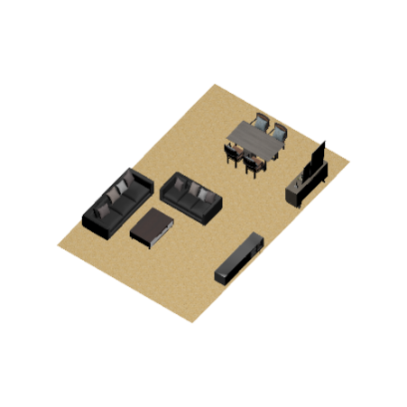
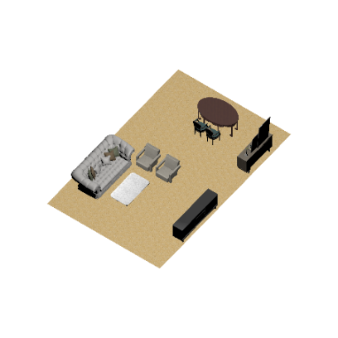
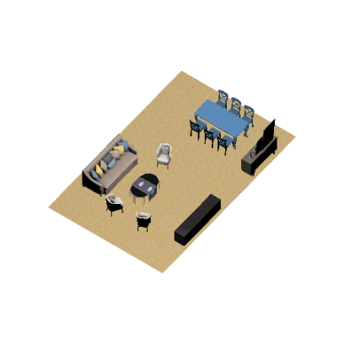
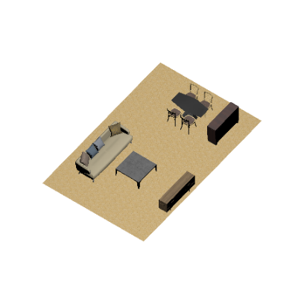
Goal
Input
Output

Slide 6
Related works

Slide 7
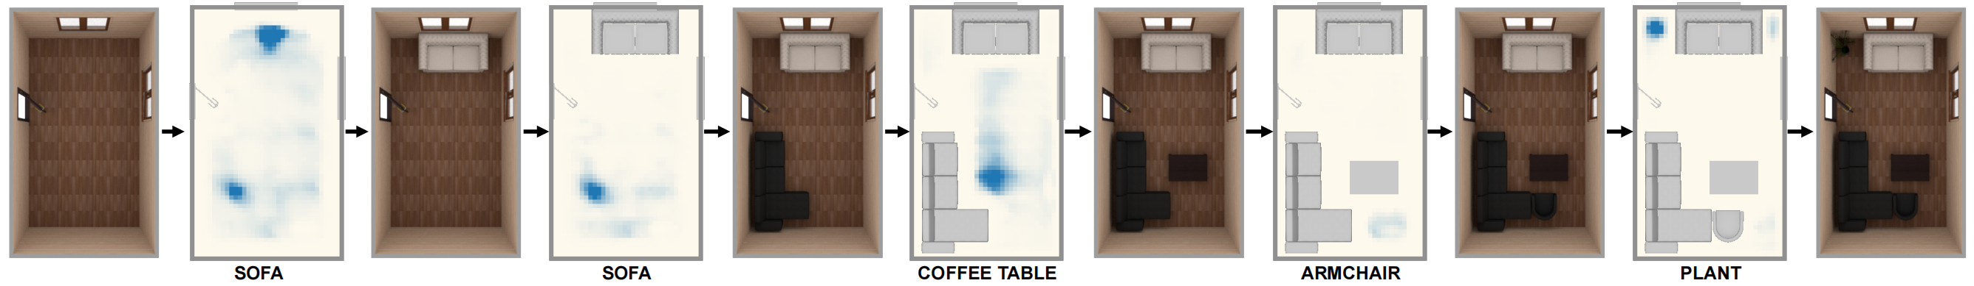
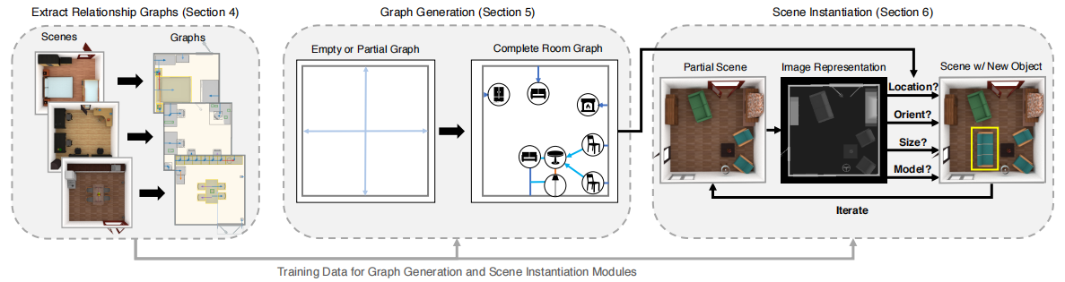
Existing methods
Progressive indoor scene synthesis
Deep-synth [Wang et al. 2018]
Graph-based scene synthesis
PlanIT [Wang et al. 2019]

Slide 8
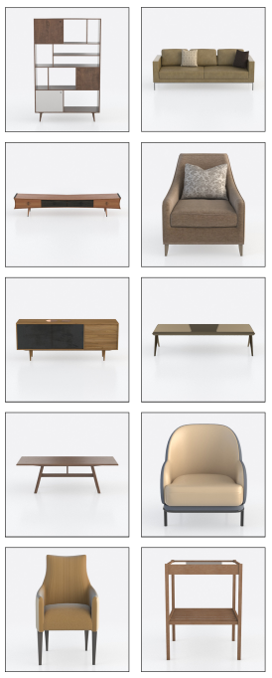
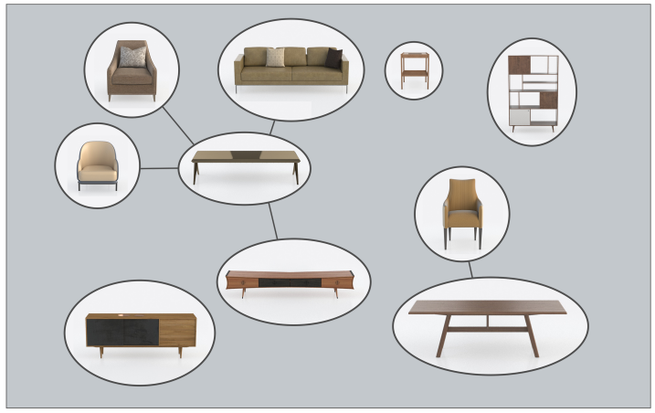
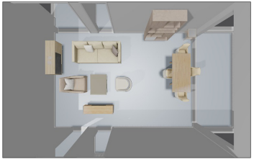
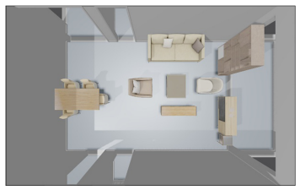
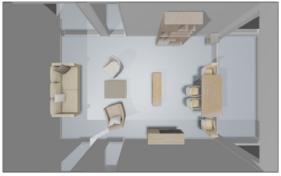
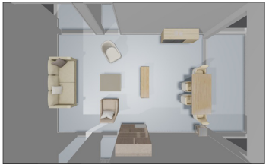
Existing methods
Function-driven scene synthesis
Zhang [Wang et al. 2021]

Slide 9
Method

Slide 10
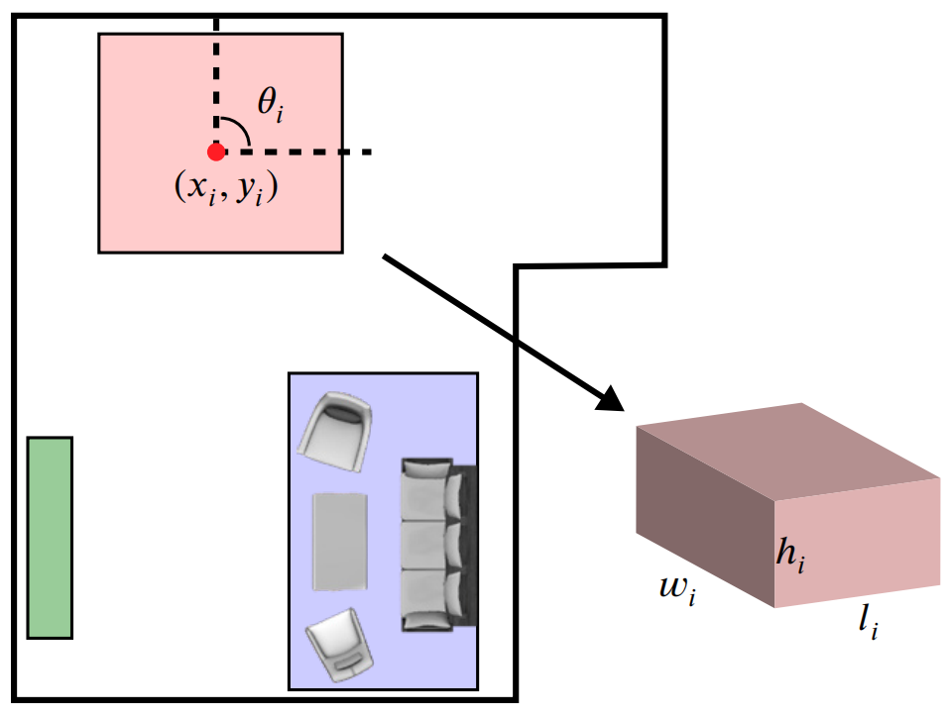
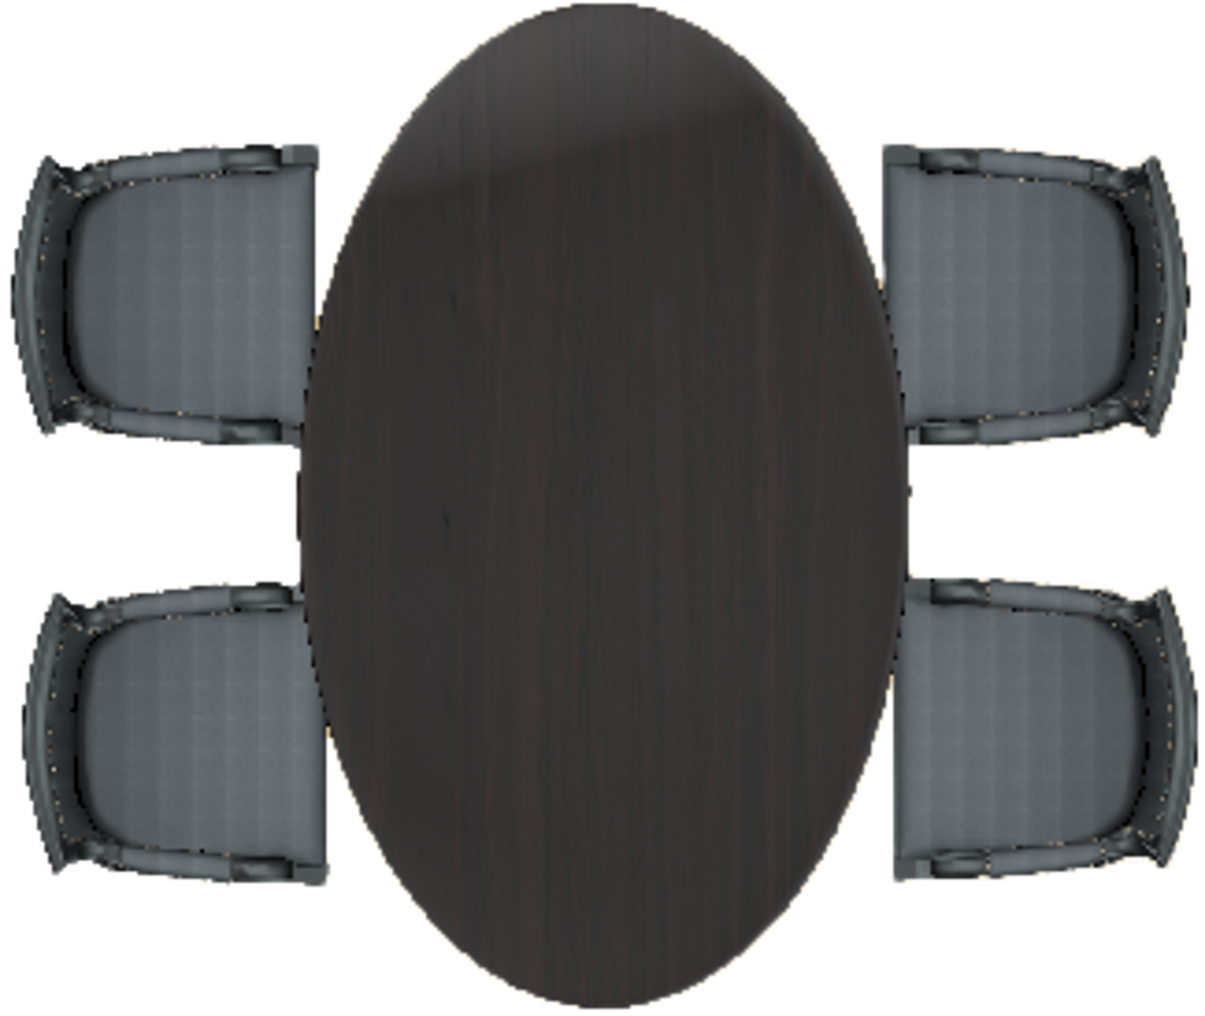

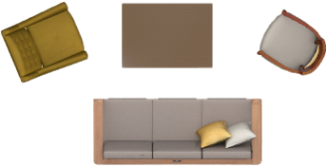


Representation
Function groups in the living room
Layout representation
Function group | Furniture
DiningGroup | DiningTable, DiningChair
ReceptionGroup | CoffeeTable, Sofa, Chair
EntertainmentGroup | TVstand
StorageGroup | Cabinet
TableGroup | CornerTable
DiningGroup
ReceptionGroup
EntertainmentGroup
StorageGroup
TableGroup

Slide 11
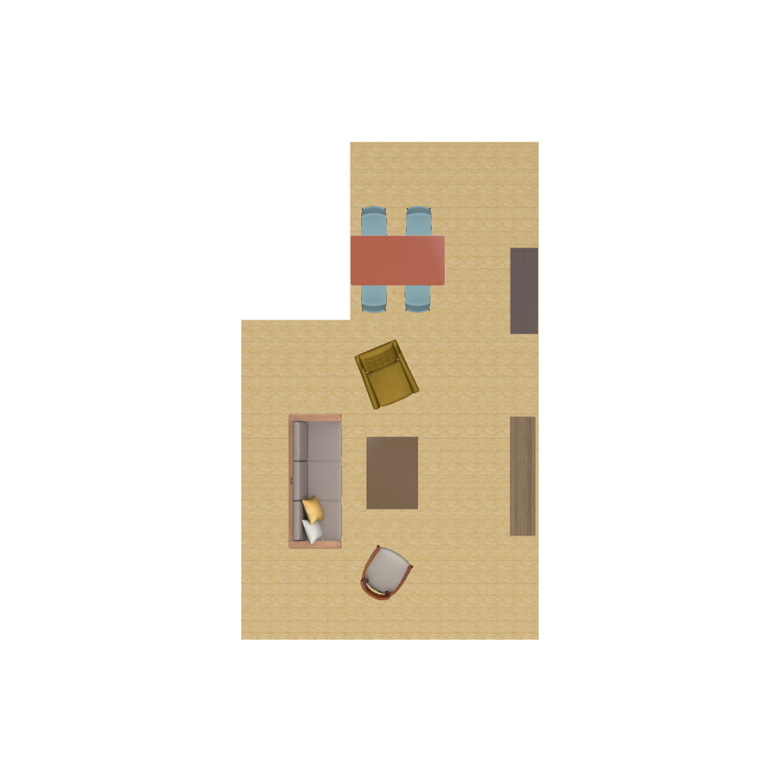
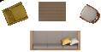


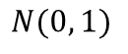
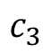
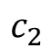
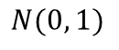
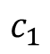
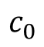
Overview
$$c_{0}$$
ResNet 18
$$c_{1}$$
R
et
r
ie
v
e
Dataset
Functional category
$$c_{2}$$
LabelVAE
$$c_{3}$$
BBoxVAE
Input
Output
$$N(0, 1)$$
S
ampling
$$N(0, 1)$$
S
ampling

Slide 12
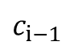
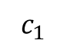
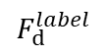
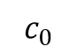
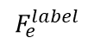
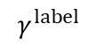
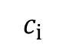
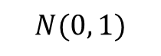
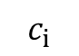
Functional category prediction
$$c_{0}$$
$$c_{1}$$
Functional category
MLP
$$c_{i}$$
$$F_{e}^{label}$$
$$c_{i}$$
$$c_{i−1}$$
Transformer Encoder
$$F_{d}^{label}$$
$$N(0, 1)$$
$$γ^{label}$$
ResNet

Slide 13

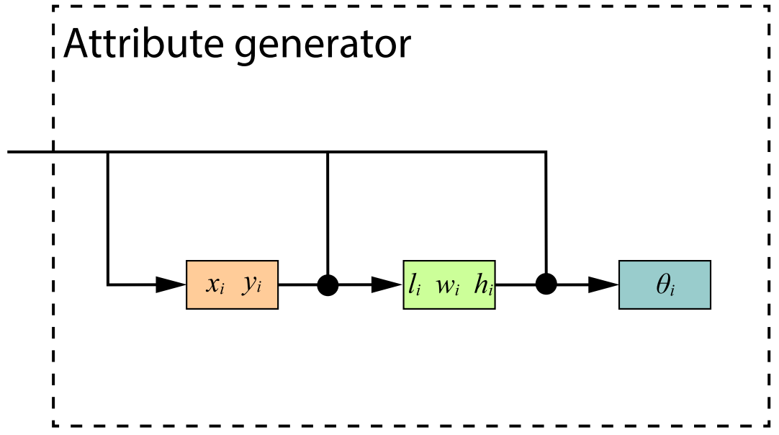
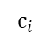
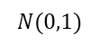
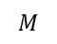
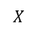
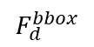
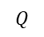
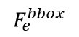
Function group generation
VAE
$$c_{i}$$
$$Q$$
BBox
$$F_{e}^{bbox}$$
$$F_{d}^{bbox}$$
$$N(0,1)$$
$$X$$
Attribute
Transformer Decoder
generator
BBox
Condition extractor
Condition extractor
$$M$$
ResNet
Transformer Encoder
Existing
function
MLP
groups

Slide 14
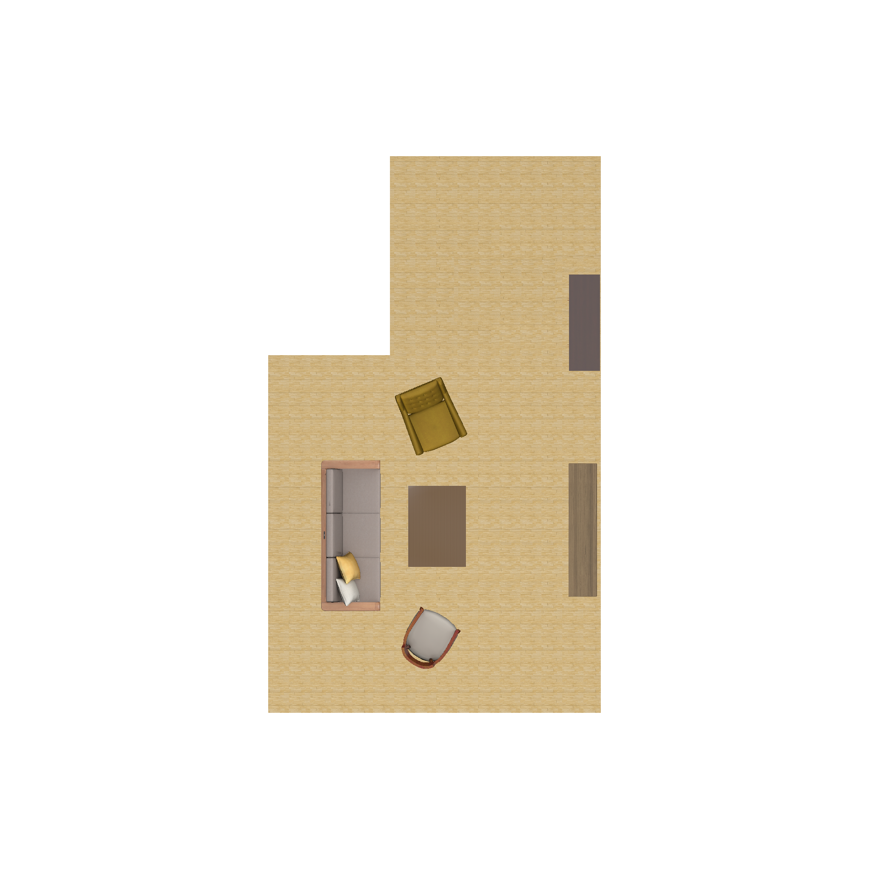
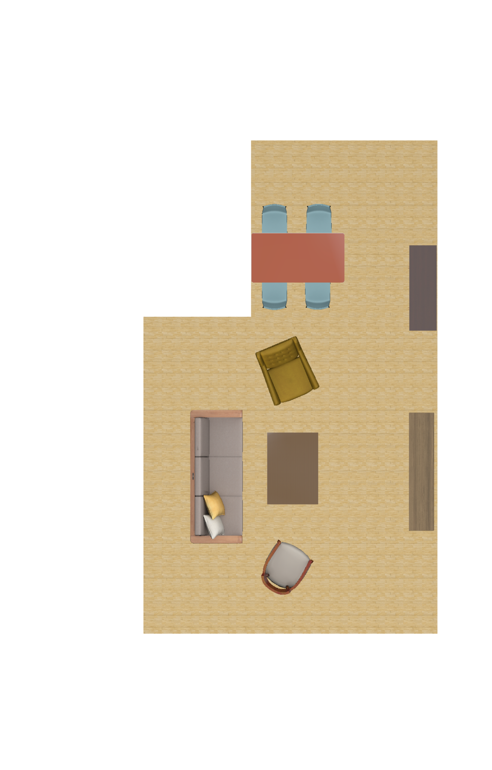
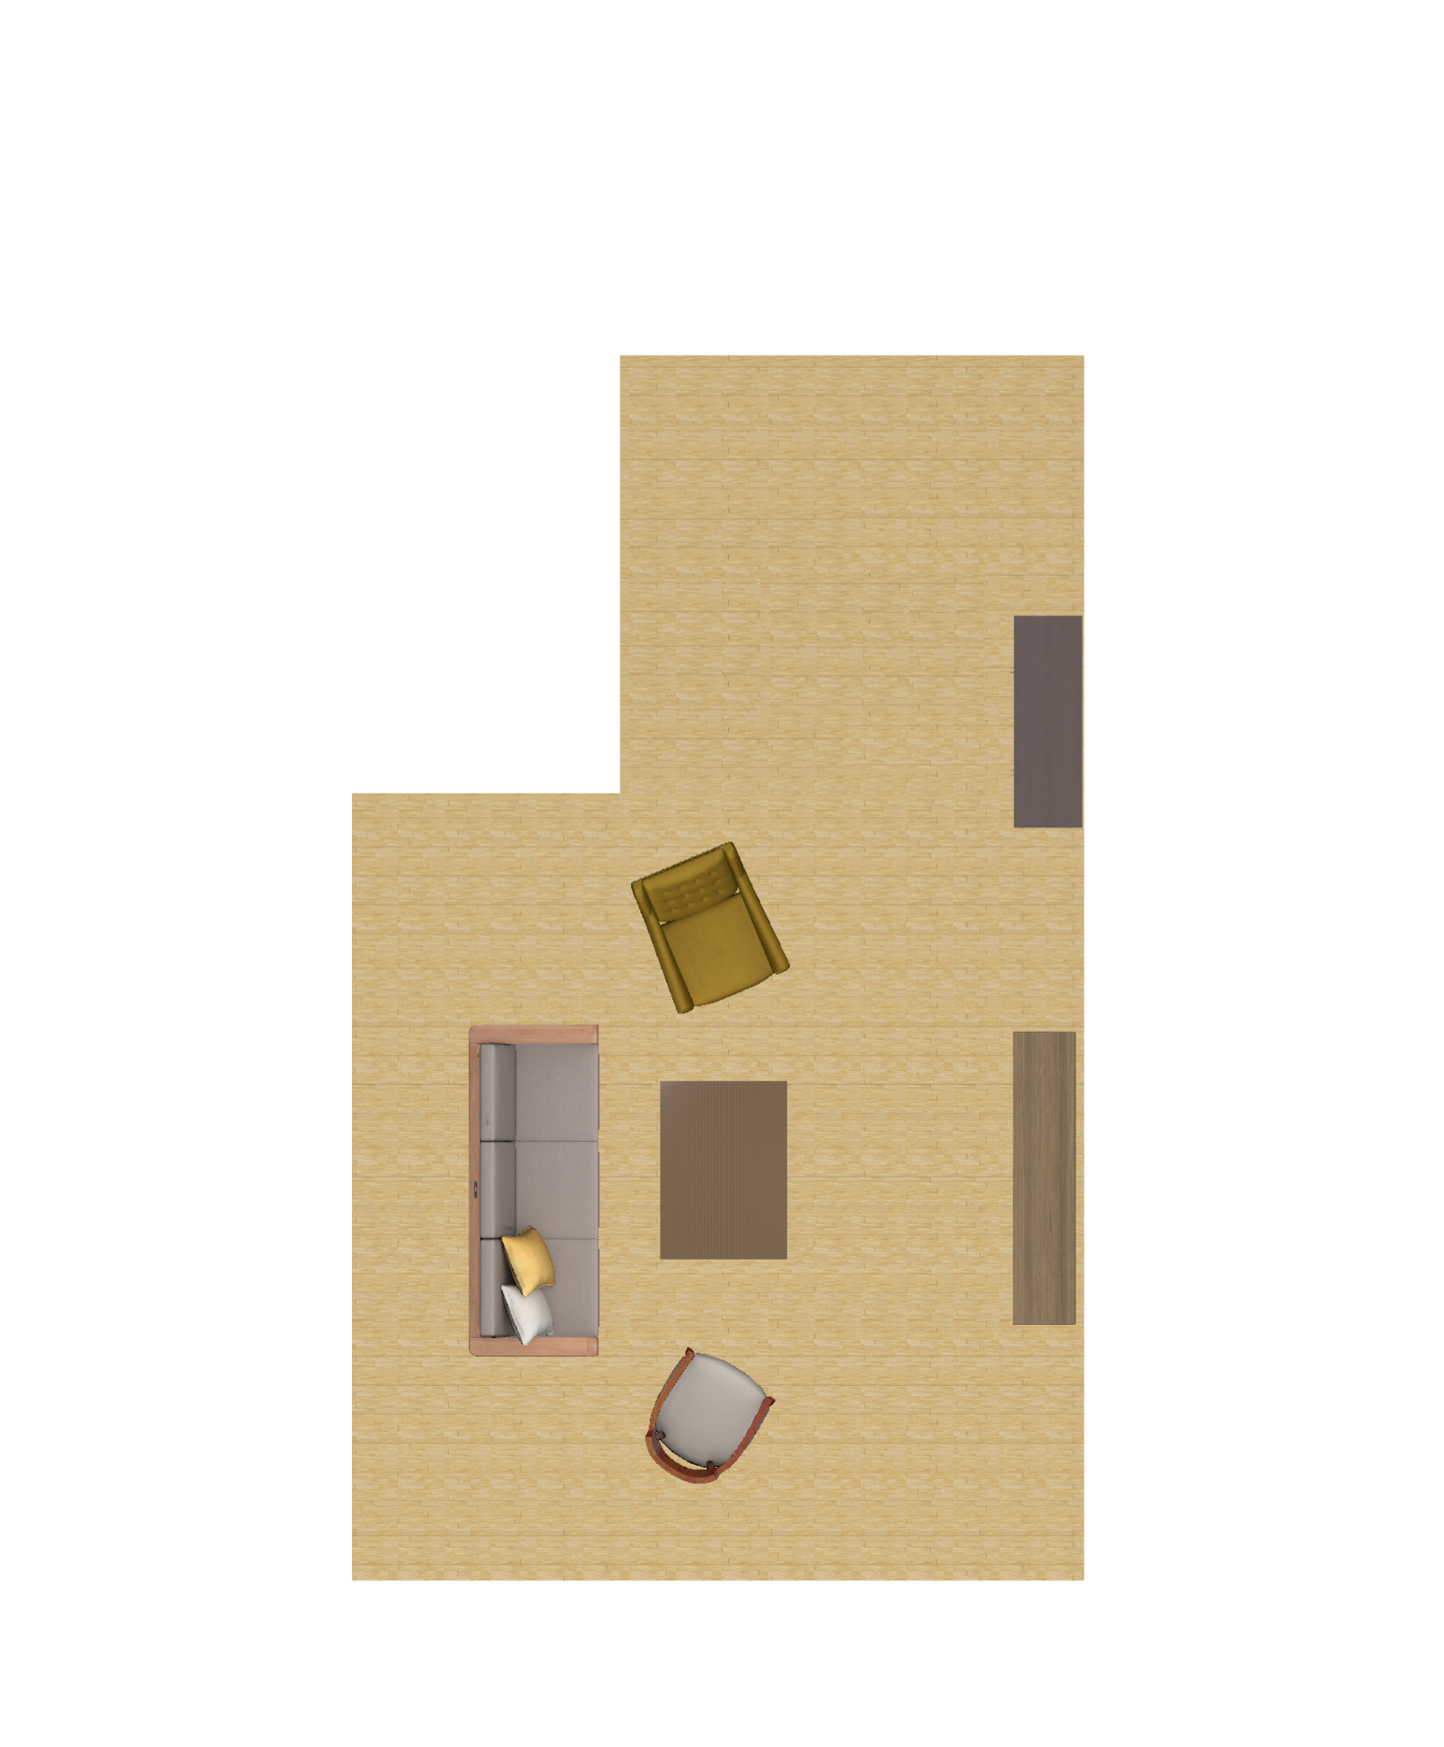







Function group instantiation
Retrieve
Dataset
Function group

Slide 15
Results

Slide 16

Results

Slide 17



Ablation Study
All-attribute generation
Fixed-order generation
Ours (Per-attribute & adaptive-order generation)

Slide 18
Quantitative evaluation
Method | FID | CA | TIME | FI
ATISS | 54.46 | 0.6996 | 2.432 | 0.7976
LayoutVAE | 103.4 | 0.9560 | 2.595 | 0.8710
Ours | 54.36 | 0.6607 | 1.891 | 0.9092
FID: It is used to calculate the distance between two distributions.
CA: It is used to calculate scene classification accuracy.
TIME: It calculates the average time in seconds required to generate an indoor scene.
FI: It is used to evaluate the functional integrity of the generated indoor scene.
ATISS: Paschalidou, D., Kar, A., Shugrina, M., Kreis, K., Geiger, A., Fidler, S., 2021. Atiss: autoregressive transformers for indoor scene synthesis. Advances in Neural Information Processing Systems. 34, 12013–12026.
LayoutVAE: Jyothi, A.A., Durand, T., He, J., Sigal, L., Mori, G., 2019. Layoutvae: stochastic scene layout generation from a label set. In: Proceedings of the IEEE/CVF International Conference on Computer Vision, pp. 9895–9904.

Slide 19

FI comparison
ATISS
LayoutVAE
Ours

Slide 20




Qualitative comparison
GT
ATISS
LayoutVAE
Ours

Slide 21



Perceptual study
Which one do you think is more plausible in the following scenes?
1
2
3

Slide 22

Perceptual study
preference ratio
Voting results of perceptual studies

Slide 23









Application: Scene completion
Partial Scene
GT
ATISS
LayoutVAE
Ours

Slide 24




Application: Control of constraints
GT
Partial label constraint
Complete label constraint
Complete label & partial bounding box constraint

Slide 25
Conclusion

Slide 26



Conclusion
A novel function-centric indoor scene synthesis framework with VAE for synthesizing multiple functional indoor scenes
A multi-level generation control for indoor scene synthesis

Slide 27
Conclusion
Limitations
Limited data sets
Limited function group categories
Future work
Increase more high-quality data
Introduce more function groups of different scenes

Slide 28
Acknowledgements
All participants of perceptual studies
All anonymous reviewers
All funding agencies

Slide 29

THANKS!

